Slide 1

Customer Behavior Analysis: Driving Business Growth
Understanding customer behavior is crucial for enhancing business performance, boosting retention, and increasing revenue. This report details an end-to-end analysis of customer data to uncover actionable insights.

Slide 2
Our Approach: A Three-Stage Analytical Pipeline
01
02
03
Data Exploration & Cleaning (Python)
Structured Analysis (SQL)
Interactive Visualization (Power BI)
Initial processing and refinement of raw customer data using Python for accuracy and consistency.
In-depth querying and extraction of insights from the cleaned data stored in a MySQL database.
Development of dynamic dashboards for intuitive exploration and presentation of key findings.
This comprehensive approach ensures robust insights into spending patterns, product performance, and demographic trends.

Slide 3

Dataset Overview: A Deep Dive into Customer Transactions
Our analysis utilized a rich dataset comprising transactional and demographic information, providing a holistic view of customer interactions.
Dataset Summary
Key Variables Include:
Total Records: 3,900
Customer ID, Gender, Age Group
Total Columns: 18
Product Category, Item Purchased
Purchase Amount, Discount Applied
Shipping Type, Subscription Status
Previous Purchases, Review Rating

Slide 4

Data Preparation & Exploratory Analysis in Python
Initial analysis in Jupyter Notebook laid the foundation, ensuring data quality and readiness for advanced querying.
Exploratory Data Analysis (EDA)
Understanding data distributions
Identifying missing/inconsistent values
Analyzing purchase amount trends
Exploring relationships between attributes
Data Cleaning & Feature Engineering
Missing values replaced statistically
New columns created for deeper insights
Data types and formats standardized

Slide 5


SQL Analysis: Unveiling Key Spending Patterns
Leveraging MySQL, structured queries revealed critical patterns in customer spending and product engagement.
Revenue by Gender
High-Value Purchases with Discounts
Identified varying revenue contributions to tailor gender-focused campaigns.
Confirmed that strategic discounts can drive significant purchase values without compromising profitability.
Top 5 Products by Rating
Highlighted highly-rated products for prioritized marketing and inventory planning.

Slide 6

Shipping & Subscriptions: Impact on Purchase Behavior
Our SQL analysis further explored how shipping choices and subscription statuses influence customer spending and loyalty.
Shipping Type vs. Purchase Amount
Subscription Status & Spending
Express shipping customers show higher average purchase amounts.
Subscribed customers spend more and generate higher total revenue.
Suggests a correlation between faster delivery and increased spending.
Emphasizes the value of subscription models for sustained growth.
These insights inform strategies for incentivizing premium shipping and boosting subscription adoption.

Slide 7

Optimizing Product & Customer Segmentation
Further SQL queries helped us understand discount effectiveness and segment customers for tailored engagements.
Products with Highest Discount Usage
Identified price-sensitive products to optimize discount strategies and maintain profitability.
Customer Segmentation by History
Segmented customers into New, Returning, and Loyal groups for targeted retention and reward programs.
Top Products Within Each Category
Pinpointed best-performing items to prioritize in inventory and promotional efforts.

Slide 8

Repeat Buyers & Revenue by Age Group
Analyzing repeat purchases and age-group revenue helps refine marketing focus and loyalty programs.
Repeat Buyer Analysis
Revenue Contribution by Age Group
Subscribed customers are significantly more likely to be repeat buyers.
Young Adults contribute the highest share of revenue.
Middle-aged customers follow closely, indicating key target segments.
Reinforces the benefits of robust customer subscription programs.
Focusing marketing efforts on these valuable segments can maximize ROI.

Slide 9
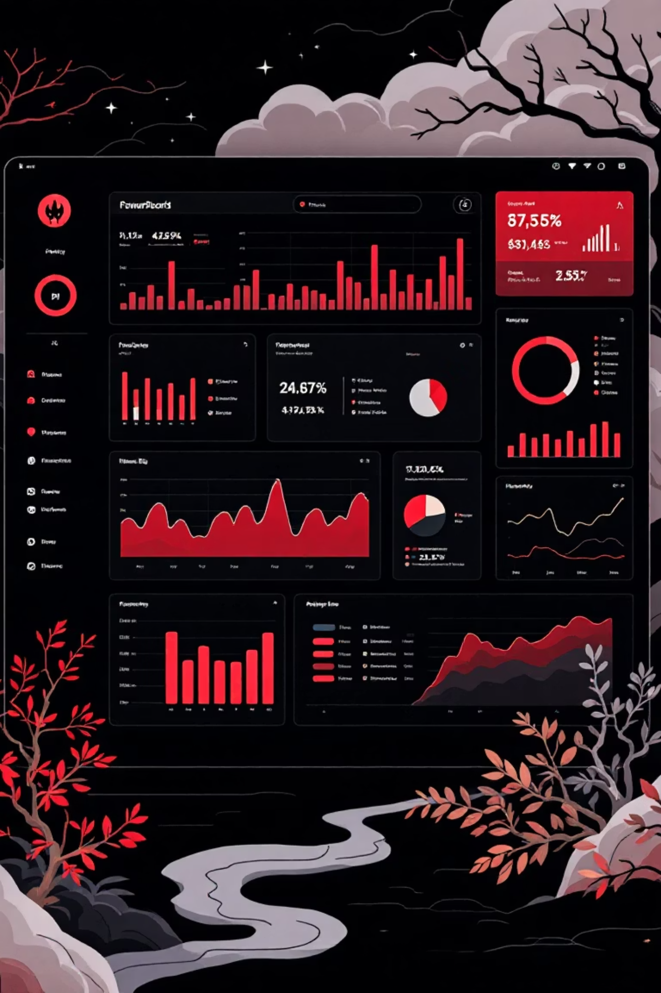
Power BI Dashboard: Interactive Insights at Your Fingertips
The final dataset was integrated into Power BI, creating a dynamic dashboard for real-time exploration of insights.
Key Performance Indicators
1
Total Customers
Average Purchase Amount
Average Review Rating
Detailed Analysis Views
Category-wise Revenue
2
Purchase Analysis
Subscription Segmentation
Age-Group Performance
Interactive Features
3
Customizable Filters
Drill-down Capabilities

Slide 10





Actionable Business Recommendations
Our comprehensive analysis provides clear pathways for improving customer retention and business performance.
Increase Subscription Adoption
Offer exclusive benefits to boost subscription rates and customer loyalty.
Target High-Revenue Age Groups
Focus marketing campaigns on Young Adults and middle-aged customers for optimal impact.
Strengthen Top Categories
Prioritize inventory and promotions for high-performing product categories like Clothing.
Optimize Discounting
Implement targeted discounts rather than broad promotions to maintain profitability.
Promote Faster Shipping
Highlight express shipping options to encourage higher average order values.

